Slide 1

FINAL PROJECT DS105
NAME: WONG WOON YONG
STUDENT No.: ML2020044

Slide 2
Background
* A multinational bank aiming to increase their market share in Europe:
Issues
Declined of customers using banking services.
Worried existing customers stopped using as main bank.
Expectation (Marketing Team)
Interesting on findings from the prediction.
Better understand existing customer behavior.
Possibly predict customer churn.
Aim (Marketing Team)
Use budget wisely to target the right potential churners.

Slide 3
Introduction
As a Data Scientist
Handling customer churn in banking sector is important, based on the “Churn Modeling” data provided,
Approach
Apply Machine Learning to find out reasons of customer churn.
Machine Learning to predict customer churn in Europe market.

Slide 4
Data understanding / Preprocessing
Data consists 12 features and 10000 customers information,
Input and Target for each features:
CustomerID = irrelevant data
CredRate = to be use as Input
Geography = to be use as Input
Gender = to be use as Input
Age = to be use as Input
Balance = to be use as Input
Tenure = to be use as Input
Prod Number = to be use as Input
HasCrCard = to be use as Input
ActMem = to be use as Input
Estimated salary = to be use as Input
Exited = used as OUTPUT, the prediction target. Data with “1” represent customer has left the bank and “0” for customer still with the bank.

Slide 5
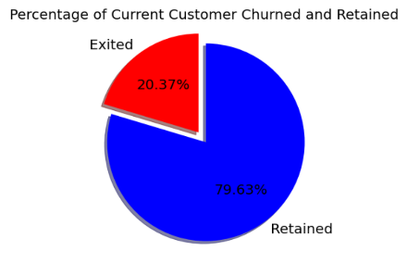
Data understanding / Preprocessing
Understand current situation based on “Exited” customer or churned data.
Pie-chart to visualize with percentage.
20% of the customer have churned – set baseline prediction as 20%.
Main focus:
1) Understand reason behind churn.
2) Predicting churn for Retained (customer).

Slide 6
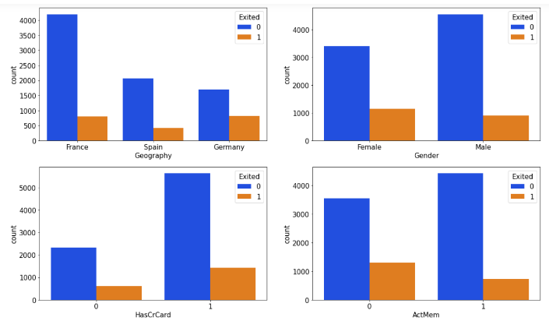
Data understanding / Preprocessing
Visualized Categorical Data - Bar-chart
1) Geography: Majority or high population from France
Possibility: 1) Poor customer service, 2) Resources allocation issues
2) Gender: Less Female customer but churned greater.
3) HasCrCard: Majority of churned customers are those having credit cards (not good sign).
Possibility: Service and benefit of the cards.
4) ActMem: Inactive member likely to churn.
→ Suggestion: Implement activities that turn inactive member to active (surely improve churn situation).

Slide 7
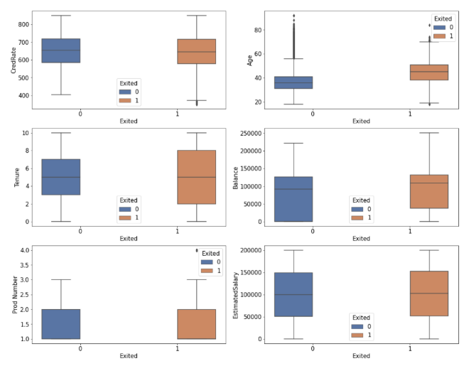
Data understanding / Preprocessing
Visualized Continuous Data – Box-plot
1) CredRate: Not much different based on Credit Score.
2) Age: Older customer likely churn
Possibility: Different preference with different age group.
→ Suggestion: Look into marketing strategy on different age groups.
3) Tenure: Customer spent extremely more or little time with bank are likely to churn.
4) Balance: Likely those have balanced (not a good sign).
Drain out of available loan funds for the bank.
5-6) Product Number and Estimated Salary: No significant sign of churn.

Slide 8
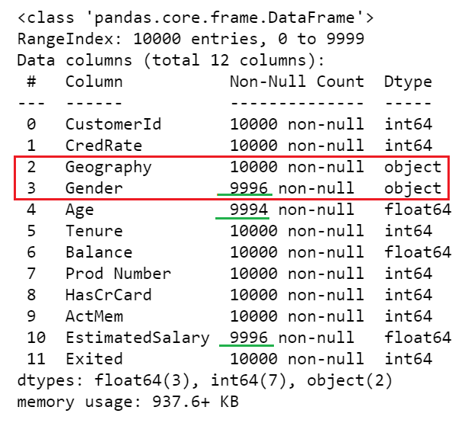
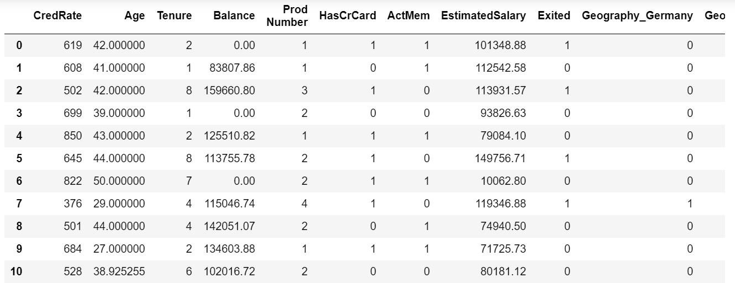
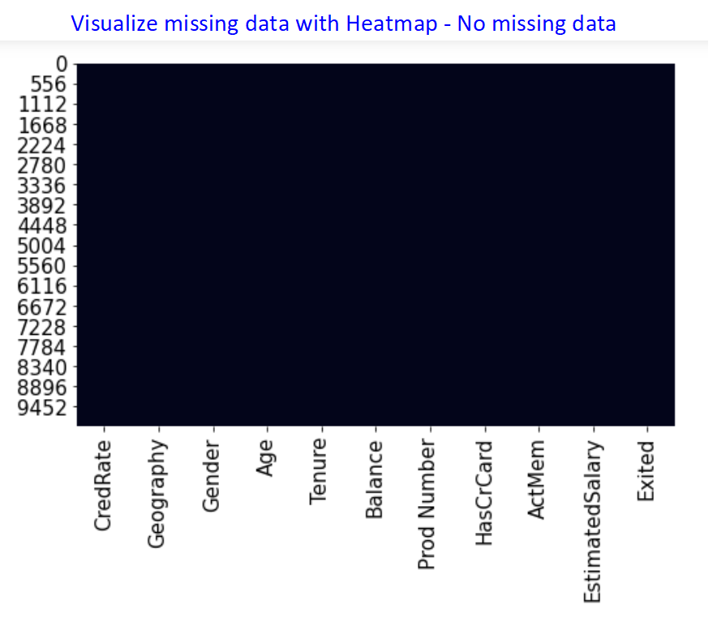
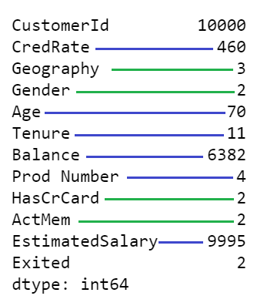
Data understanding / Preprocessing
Data pre-processing and Features Engineering is handling missing data and converting data into numeric representative that will be understand by the algorithms.
1) Drop the irrelevant data of CustomerId.
2) Impute missing values for Age and EstimatedSalary with Mean.
3) Replace missing Gender with Frequency (Mode).
4) Object data type of Geography and Gender handle with One-Hot-Encoding.

Slide 9
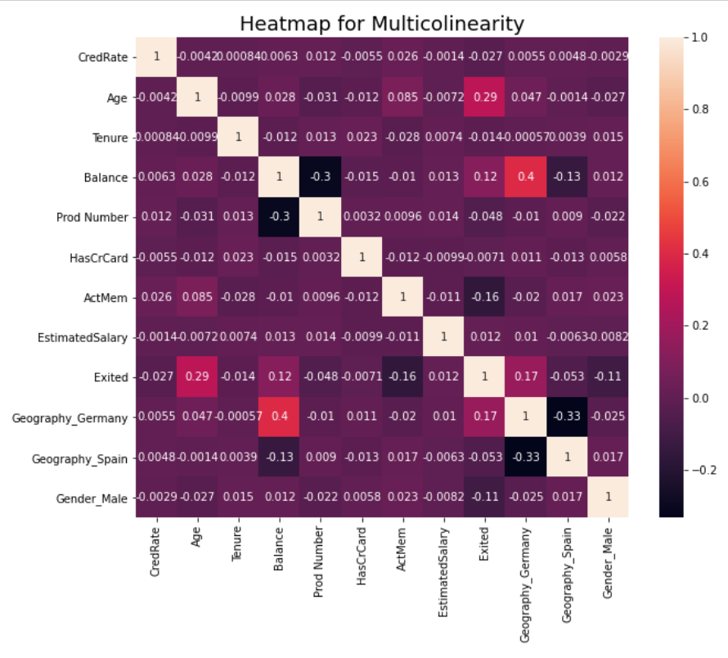
Machine Learning Model Training
Prediction on customer churn is Classification problem, either customer stays or leaves.
Algorithms use are most common and recognized in handling this problem.
1) Logistic Regression: Predict or guess the probability of belonging in either zero or one.
→ Check Multicolinearity issues: must be little or no correlated between the independent variables (features = X).
2) Decision Trees: For classification and recognized method for predicting customer churn.
3) Random Forest: Capable handling large data, fitting non-linear data or even features with correlation.

Slide 10
Evaluation / Results
Evaluation Metrics used:
1) Confusion Metrix table: Summarized correctly classified and incorrectly classified.
2) Precision: Ratio of correctly predicted positive over total positive.
3) Recall: Ratio of correctly predicted positive over all observations in actual.
4) Accuracy: Accurate of the prediction.
5) AUC score: Capability of models in differentia customer churn or not churn.
6) ROC curve plot.

Slide 11
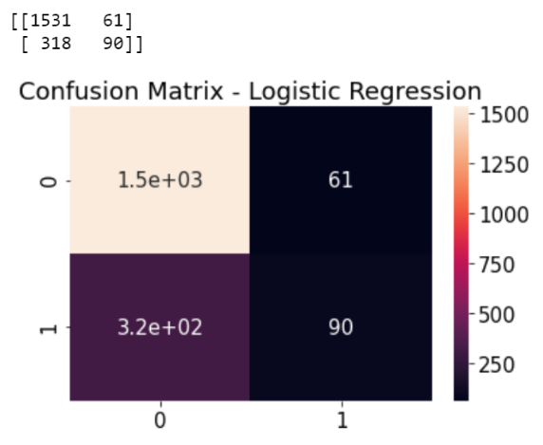
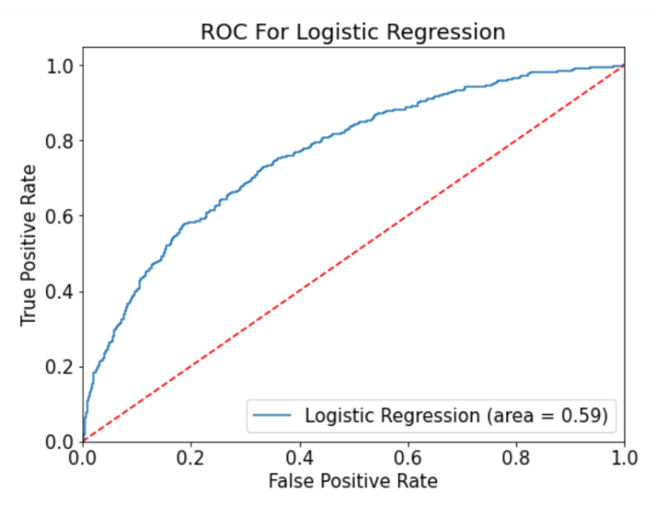
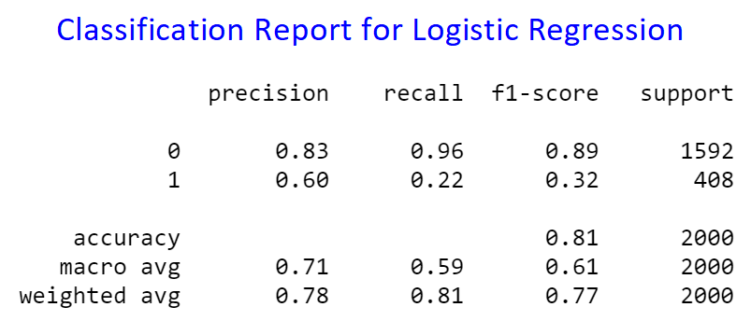
Evaluation / Results
1) Result for Logistics Regression:
Confusion Matrix: 1531 correctly predicted and 318 incorrect.
Classification Report: Accuracy score 81%. Performance metrics in predicting customer not churn is good. However, prediction of customer will churn (class 1) is less accurate.
→AUC score for the model is 0.59 (Moderate).

Slide 12
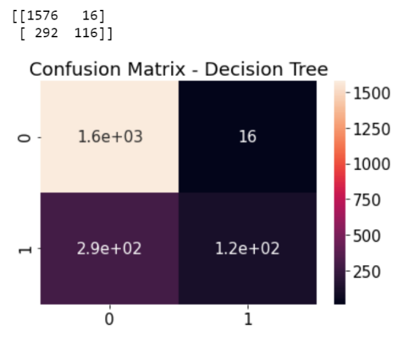
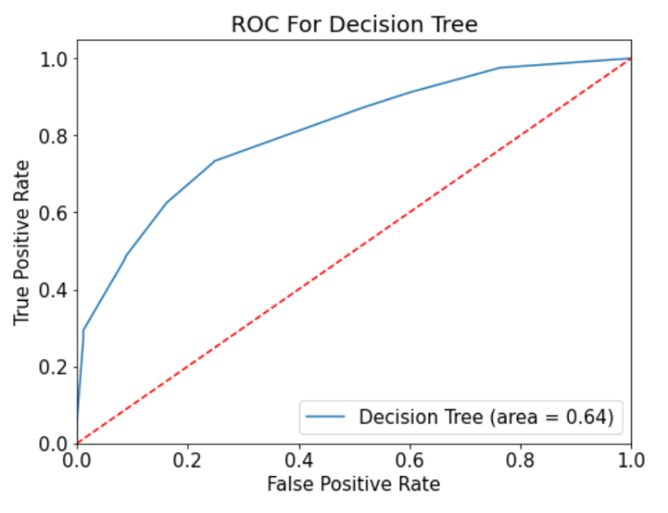
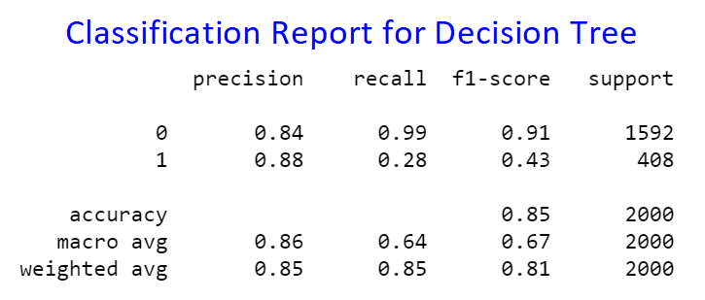
Evaluation / Results
2) Result for Decision Tree:
Confusion Matrix: 1576 True Positive correctly predicted and 292 incorrect.
Classification Report: Accuracy score 85%. Performance metrics in predicting customer not churn is better then Logistic Regression. Prediction customer will churn improved but Recall and F1-score still less accurate.
→AUC score for the model is 0.64 (above Moderate), 8.5% better than Logistic Regression Model.

Slide 13
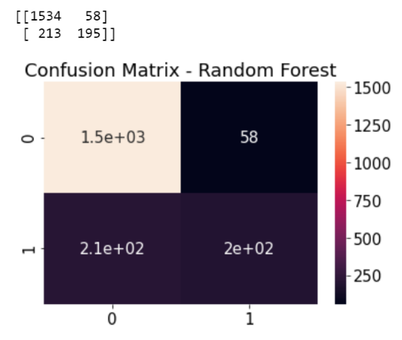
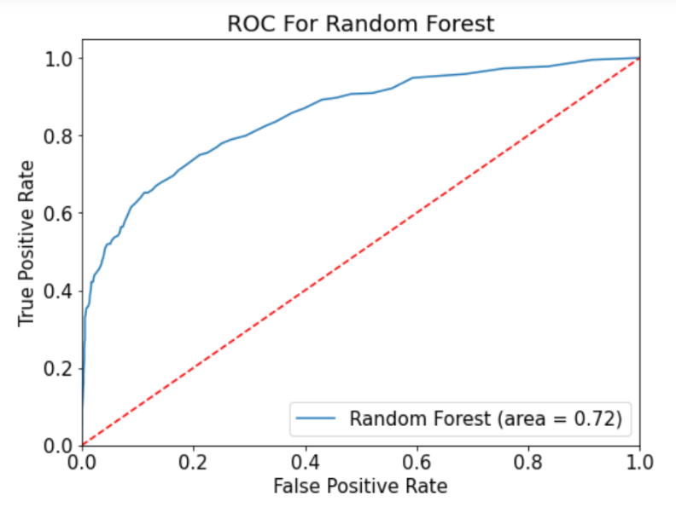
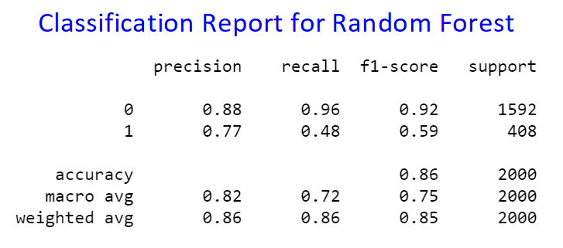
Evaluation / Results
3) Result for Random Forest:
Confusion Matrix: 1534 True Positive correctly and 213 incorrect.
Classification Report: Best result among the 3 models, Accuracy score is 86%. Performance metrics in predicting customer not churn is the best. Prediction customer will churn is quite balance, with Precision 0.77, Recall and F1-score is the best compare to the other two models.
→AUC score for the model is 0.72 (Good), 12.5% better than Decision Tree Model.

Slide 14
Conclusion
The result from each model clearly indicated that the prediction is worked and able to provide some insight for the stakeholders. With the Accuracy from Logistic Regression at 81%, it increases to 85% with applying Decision Tree and lastly increased to 86% with Random Forest. Since the model has reached an accuracy of 86%, this mean it can predict 8.6 out of 10 times correct be it a customer is likely to churn or not. This is a useful data for the marketing team to allocate their budget correctly.
This project provides me a new learning experience in term of predicting customer churn, it also allowed me to work in different type of plotting and make me realized that the important of Data Visualization can help in better understanding the results. Moving forward I would like to practice and explored more on the Machine Learning especially prediction on real live or work-related issues.

Slide 15
Q & A
- End -

